Slide 1




HackOrbit - 2025
Team Name :
Tech Titans

Slide 2

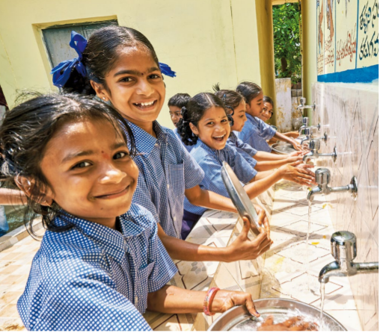
THEME & PROBLEM STATEMENT
Theme: Artificial Intelligence and Machine Learning
Problem Statement: In rural and government schools of India, hygiene conditions like toilets, kitchens, and drinking water areas are often not properly maintained. Manual inspections are irregular and paper reports are unreliable. This leads to unhealthy environments for children and increases the risk of diseases.

Slide 3
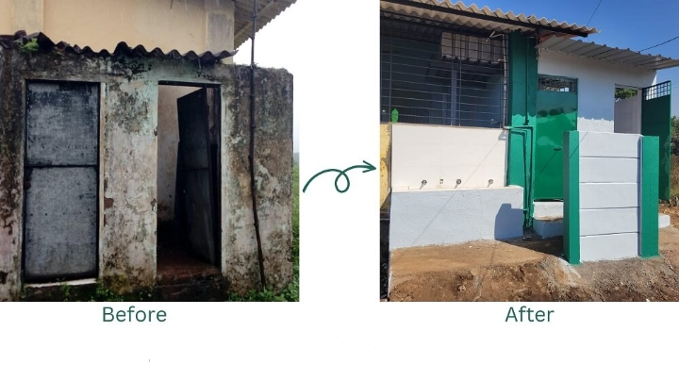
PROPOSED SOLUTION
1) Photo Collection
Teachers or staff take daily/weekly photos of hygiene areas (toilets, kitchens, handwash points, etc.) using a mobile app or a simple Google Form.
2) AI Image Analysis
An AI model (trained using TensorFlow Lite) scans images for:
Trash presence
Water leaks
Dirty floor
No soap
Overflowing dustbins
3) Hygiene Score Generation
AI model gives a hygiene score
(like 0–100) based on the issues
found.

Slide 4
PROPOSED SOLUTION (CONTINUED)
4) Report and Suggestions
The system generates a simple report with:
Hygiene score
Problems found
Suggestions (clean area, refill soap, fix tap)
5) Dashboard View
A simple web dashboard shows hygiene reports, problem trends, and highlights schools needing attention.
6) Auto Alerts
If hygiene score is below a set level (like 60), send SMS or email to school/district officer.

Slide 5
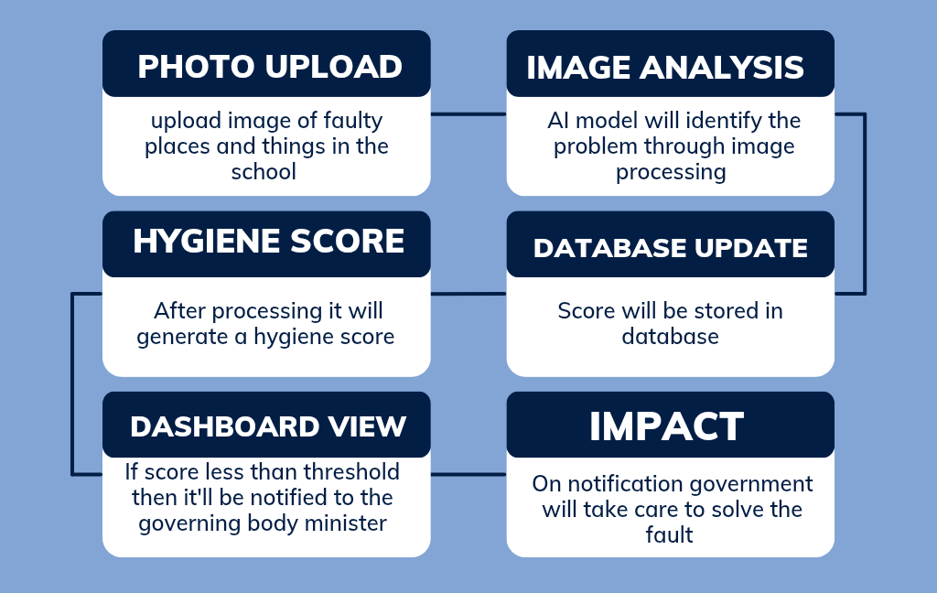
FLOWCHART / DIAGRAM

Slide 6
FLOWCHART EXPLANATION
Photo Upload: Staff upload photos of hygiene areas through mobile app or form.
AI Image Analysis: AI model checks for trash, leaks, soap, and cleanliness.
Hygiene Score + Report: System gives a cleanliness score and problem list.
Database Update: Data stored in Firebase.
Dashboard + Alerts: Officers view reports; alerts sent for low scores.

Slide 7
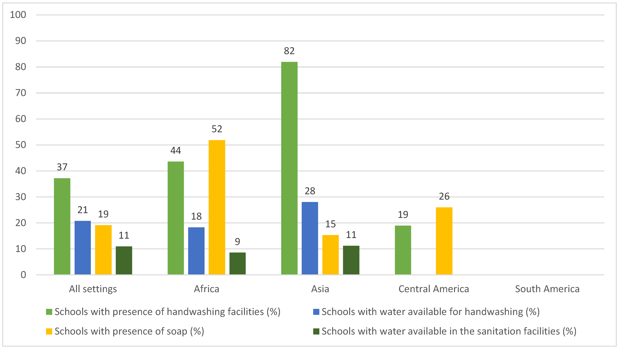
FEATURES AND NOVELTY
Features:
1) AI-based hygiene checking
using images.
2) Auto-generated hygiene scores.
3) Suggestions for improvement.
4) Simple dashboard for real-time
monitoring.
5) Auto alerts for poor hygiene scores.
Novelty:
1) First AI-based, low-cost hygiene audit for schools using photos.
2) No need for expensive sensors or heavy hardware.
3) Digital proof with image evidence.
4) Can scale to multiple schools with ease.

Slide 8
DRAWBACK (WITH SOLUTIONS) AND SHOWSTOPPERS
Drawbacks (and solutions):
1) Might need good internet for photo upload → Can store offline and sync later.
2) AI may mistakenly detect in low-light images → Basic image quality check before upload.
3) Staff may forget uploads → Simple app reminders.
Showstoppers:
1) Brings hygiene accountability with image proof.
2) Improves children’s health by maintaining clean spaces.
3) Replaces unreliable manual reports.
4) Easy and affordable to implement in rural areas.

Slide 9
Team Name : Tech Titans
Team Members Details
Name | Contact Number | Responsibility
Deepali Chauhan | +91-9027654781 | Database and Frontend Development
Abhay Kanojia | +91- 9520254594 | Ai Model Building and Backend Development

Slide 10
Thank You !!!

